Slide 1


Slide 2

Introducing Microsoft Azure Big Data Platform
Francesco Scullino

Slide 3
Agenda:
Big Data overview
Azure HDInsight
Demo
Hands-on Lab

Slide 4
Big Data overview

Slide 5
What is Big Data?
Many definitions:
Big data is high volume, high velocity, and/or high variety information assets that require new forms of processing to enable enhanced decision making, insight discovery and process optimization Gartner 2012
….
….
I like this one:
Big Data happens when the data you have to process is bigger than what you can process in the given time with current technologies Silicon Angle

Slide 6





V (I)
Big Data is often described using 3/4/5 V
Volume: refer to the large amount of data to be stored and analyzed
Velocity: refer to the speed at which new data are generated
Variety: refer to the different types of data we can process

Slide 7
V (II)
[Veracity]: refer to the quality of the data
[Value]: refer to the business decisions that can be taken at the end of big data processing

Slide 8
Suggested Readings

Slide 9
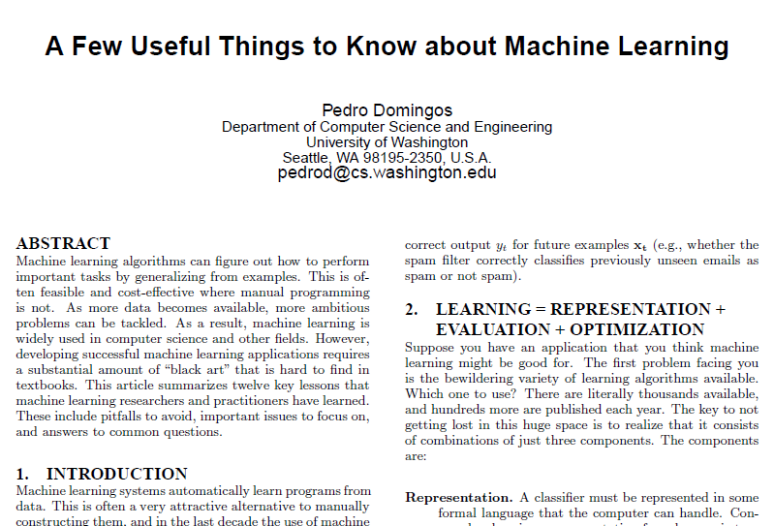

Slide 10
Want to understand the what, why, and how of predictive analytics?
Here’s a short, ordered reading list designed to get you up to speed fast…
The Signal And The Noise: Why So Many Predictions Fail — but Some Don’t by Nate Silver.
Nate Silver built an innovative system for predicting baseball performance and predicted the 2008 and 2012 elections within a hair’s breadth. The New York Times publishes FiveThirtyEight.com, where Silver is one of the nation’s most influential political forecasters. Why read: This book will inspire your “predictive” imagination and ground you in realities of predictive analytics.
Predictive Analytics: The Power To Predict Who Will Click, Buy, Lie, or Die by Eric Siegel.
Eric Siegel has written a very accessible book on how predictive analytics works. It’s chock-full of dozens of real-world examples, such as how Chase Bank predicted mortgage risk (before the recession), IBM Watson won Jeopardy!, and Hewlett-Packard predicted employee flight risk. Why read: Predictive Analytics is a perfectly paced explanation of how predictive analytics works and a repository of dozens of real examples across many use cases.
Uncontrolled: The Surprising Payoff Of of Trial-and-Error For Business, Politics, and Society by Jim Manzi.
Predictive analytics is not magic — it’s science. Jim Manzi reminds us of the power of the scientific method and reveals the shocking truth that many huge societal and business decisions are made based on misinterpreted data and statistics. Why read: Controlled experimentation amplifies the results of predictive analytics and helps avert the risk of inaccurate predictions.
Data Mining: Practical Machine Learning Tools and Techniques by Ian H. Witten, Eibe Frank, and Mark Hall.
If you write code or have a computer science background, you’ll probably want to know the gory details of how predictive analytics works. Why read: Data Mining provides a thorough grounding in machine learning concepts as well as practical advice on applying machine learning tools and techniques in real-world data mining situations.

Slide 11
Introducing Azure ML

Slide 12

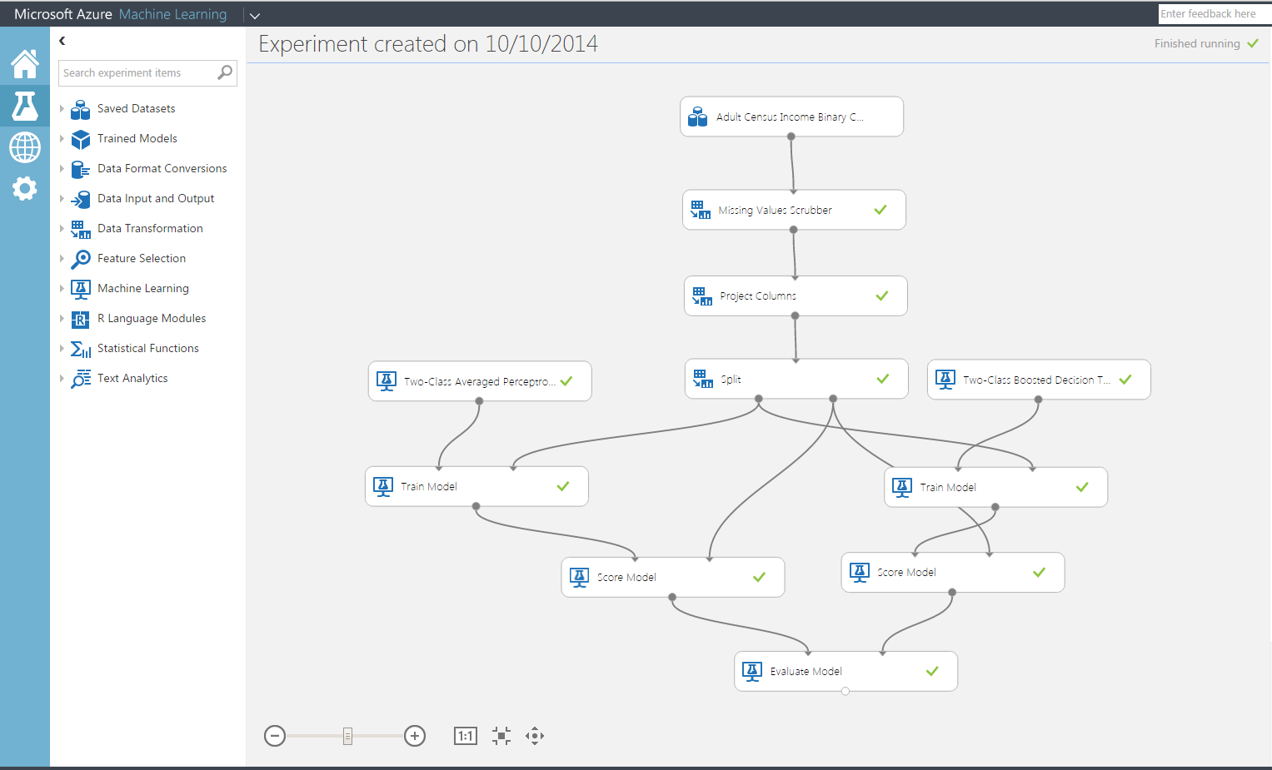
Microsoft Azure Machine Learning Features and Benefits
Reduce complexity to broaden participation
Accessible through a web browser, no software to install;
Collaborative work with anyone, anywhere via Azure workspace
Visual composition with end2end support for data science workflow;
Best in class ML algorithms;
Extensible, support for R OSS.

Slide 13
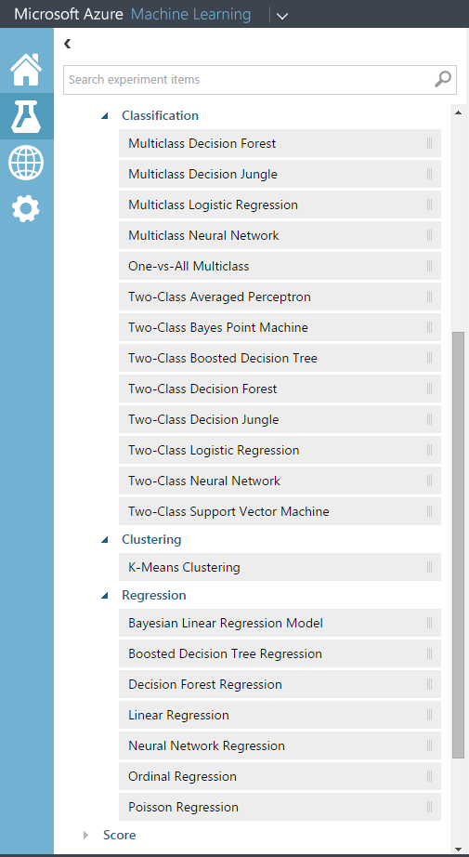
Microsoft Azure Machine Learning Features and Benefits
Rapid experimentation to create a
better model
Immutable library of models, search discover and reuse;
Rapidly try a range of features, ML algorithms and modeling strategies;
Quickly deploy model as Azure web service to our ML API service.

Slide 14





Microsoft Azure Machine Learning Publish as Azure ML Web Service
☁
☁
☁
IT Pro
consume
publish
+
ML API Service
ML Studio
enterprise
customer
data
scientist
• Highly scalable services built on Azure. Eliminate upfront costs for hardware resources.
• Scored in batch-mode or request-response mode;
• Actively monitor models in production to detect changes;
• Telemetry and model management (retrain).

Slide 15
Business problem to business value
Data
Microsoft Azure Machine Learning
API
Cloud
HDInsight
SQL Server VM
SQL DB
Blobs & tables
Local Files
ML Studio
Microsoft Azure portal
Workspace
Publish API in minutes
Local
Desktop files
Excel spreadsheet
Other data files on PC
Storage space
Web
Devices Applications Dashboards
Business problem
Modeling
Deployment
Business value

Slide 16
Online resources
Lots of stuff: https://github.com/Azure-Readiness
Free SQL Server 2014 Technical Overview e-book
microsoft.com/sqlserver and Amazon Kindle Store
Free online training at Microsoft Virtual Academy
microsoftvirtualacademy.com
Try new Azure data services previews!
Azure Machine Learning, DocumentDB, and Stream Analytics

Slide 17
Demo: Azure ML

Slide 18
Hands-On: Lab

Slide 19
Q&A Presentation credits: Raymond Laghaeian @ TechEd 2016 Rafal Lukawiecki @ Microsoft Ignite 2015
Claudio Rossi
rossi@ismb.it | @Resonance82

